Slide 1
Online Retailer Performance Analysis
Andrew Weilbacher

Slide 2
Agenda
MoM Results
Device Breakdown
Trends
ECR
Transactions
Sessions
Recommendations
Conclusions

Slide 3
MoM Results
June, 2013
Sessions
Total: 1,388,834
% Change: 19.2%
Change: 224195
Transactions
Total: 34,538
% Change: 21.6%
Change: 6149
Quantity
Total: 61,891
% Change: 19.8%
Change: 10262
Add to Cart
Total: 107,970
% Change: -21.0%
Change: -28,750
May, 2013
Sessions
Total: 1,164,639
Transactions
Total: 28,389
Quantity
Total: 51,629
Add to Cart
Total: 136,720

Slide 4
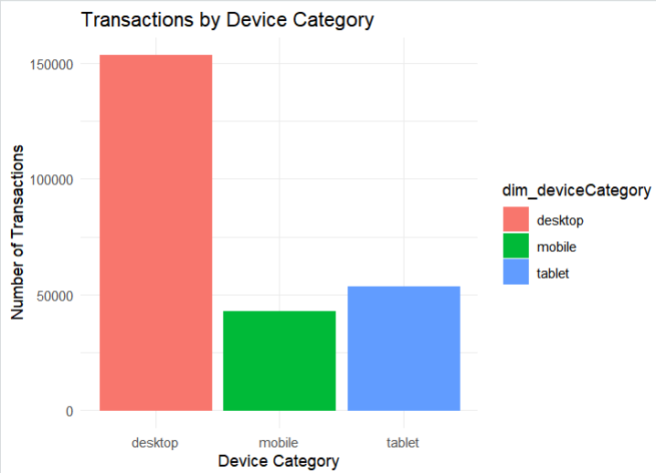
Device Breakdown
Desktop drives the most transactions

Slide 5
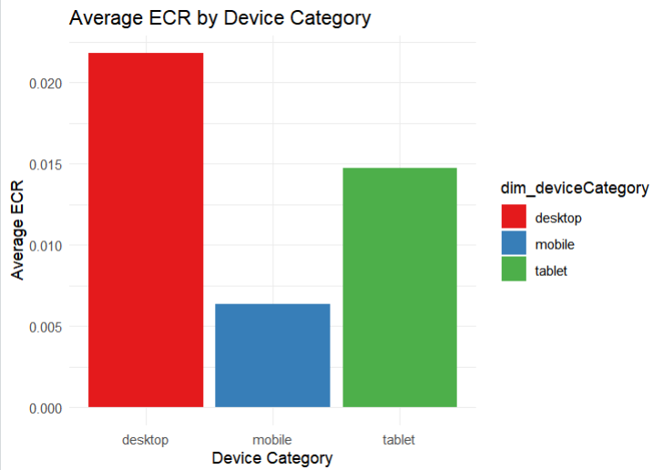
Device Breakdown
Desktop also has the highest ECR
Despite a lower number of transactions, tablets drive a relatively high ECR, thus meaning there could be efficiencies in targeting more tablets.

Slide 6
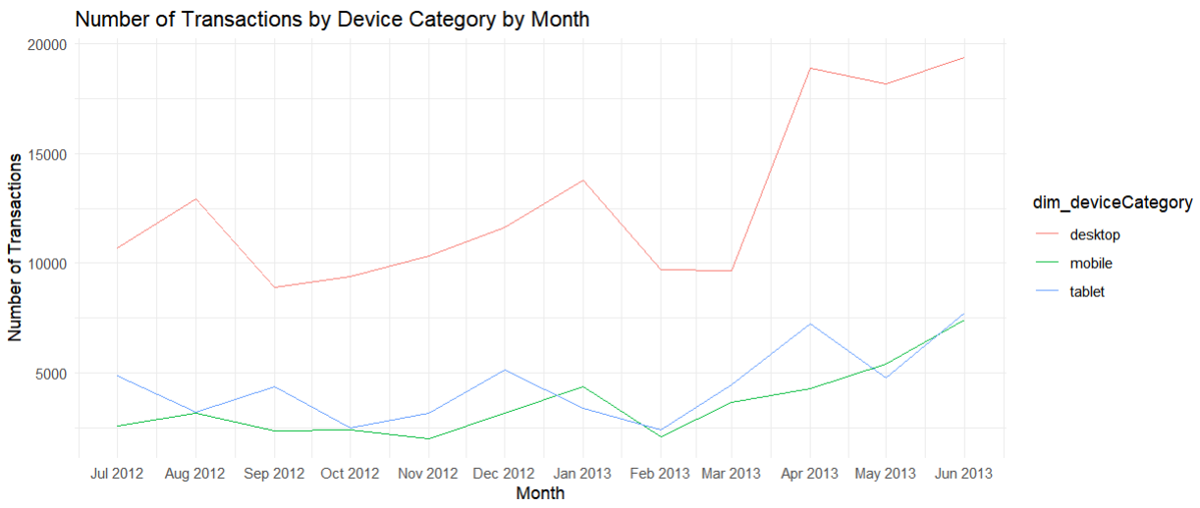
Trends
All devices are seeing healthy increases in transactions

Slide 7
Trends
All devices are seeing healthy increases in transactions

Slide 8
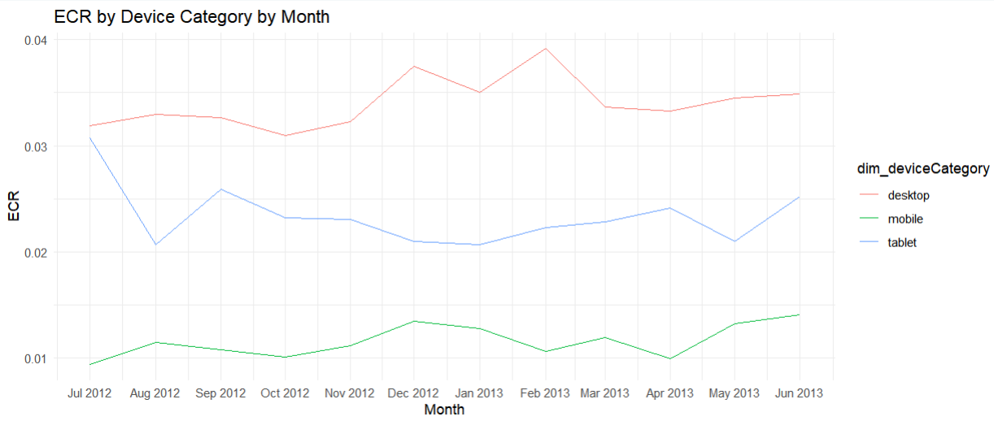
Trends
ECR has been on a uptrend throughout the year. Tablets were initially trending down, but have spiked over the past couple of months.

Slide 9
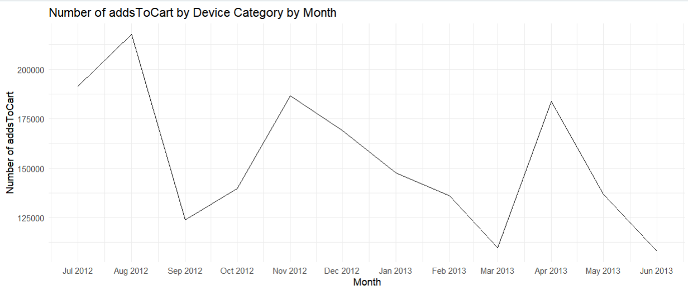
Trends
Adds to Cart have been decreasing steadily, despite the increases in transactions and sessions.

Slide 10
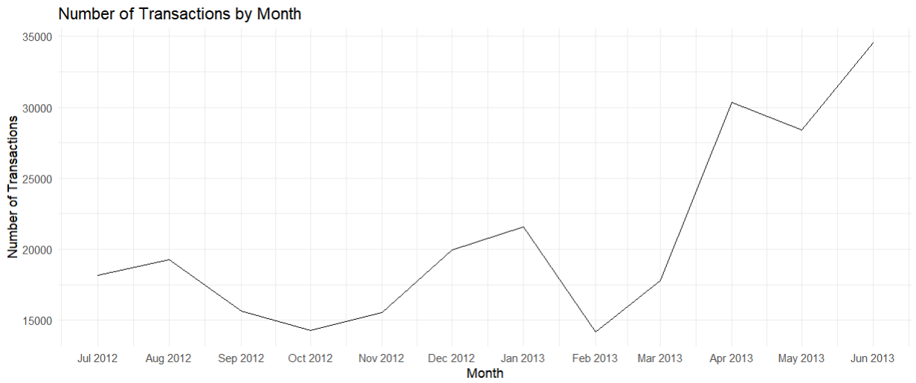
Trends

Slide 11
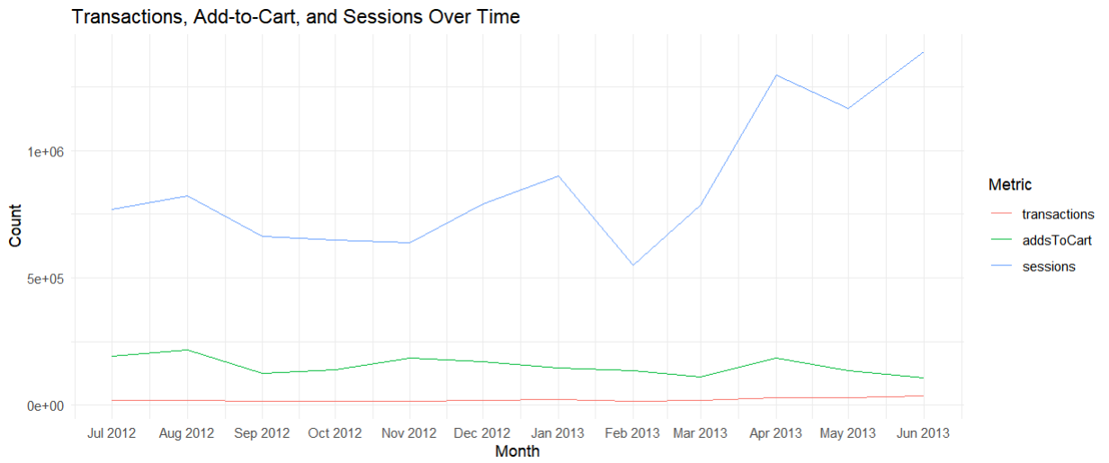
Trends

Slide 12
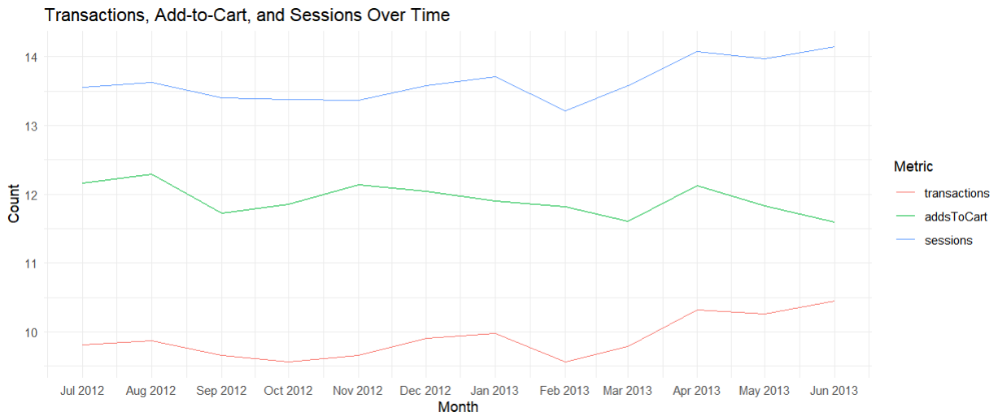
Trends
This chart uses a logarithmic scale to make it easier to compare trends. This type of scale can help show changes more clearly.

Slide 13
Trends
ECR has been on a uptrend throughout the year. Tablets were initially trending down, but have spiked over the past couple of months.

Slide 14
Recommendations
Focus on Desktop as it has the most momentum in transactions and ECR.
Break down the data by channel to determine which channels work best for Desktop.
Shift budget more towards Desktop and Tablet, but away from Mobile as it has low ECR.

Slide 15
Conclusions
Adds to Cart have been going down, yet ECR and Transactions are going up. This would suggest that targeting is improving for transactions and, potentially, the average order value is also increasing.
Traffic quality likely has improved over this period.
Desktop is a winning device and tablet has potential. Mobile could be a cause for spend inefficiencies.
Determine if any seasonal events are causing these jumps.
For example, if your products are affected by the summer and any holidays celebrated during.
If this is the case, then an additional analysis needs to be done to determine if these trends are “real”.

